Slide 1

classkart RWANDA
Group 16
Nkurunziza Fidele — Registration Number: 1CUR12AKO2462
Umubyeyi Alice — Registration Number: 1CUR23AK07387

Slide 2

ClassKart RWANDA
Empowering Learning Through Access
An innovative online platform transforming how students, teachers, parents, and schools access affordable, authentic educational materials across Rwanda.

Slide 3
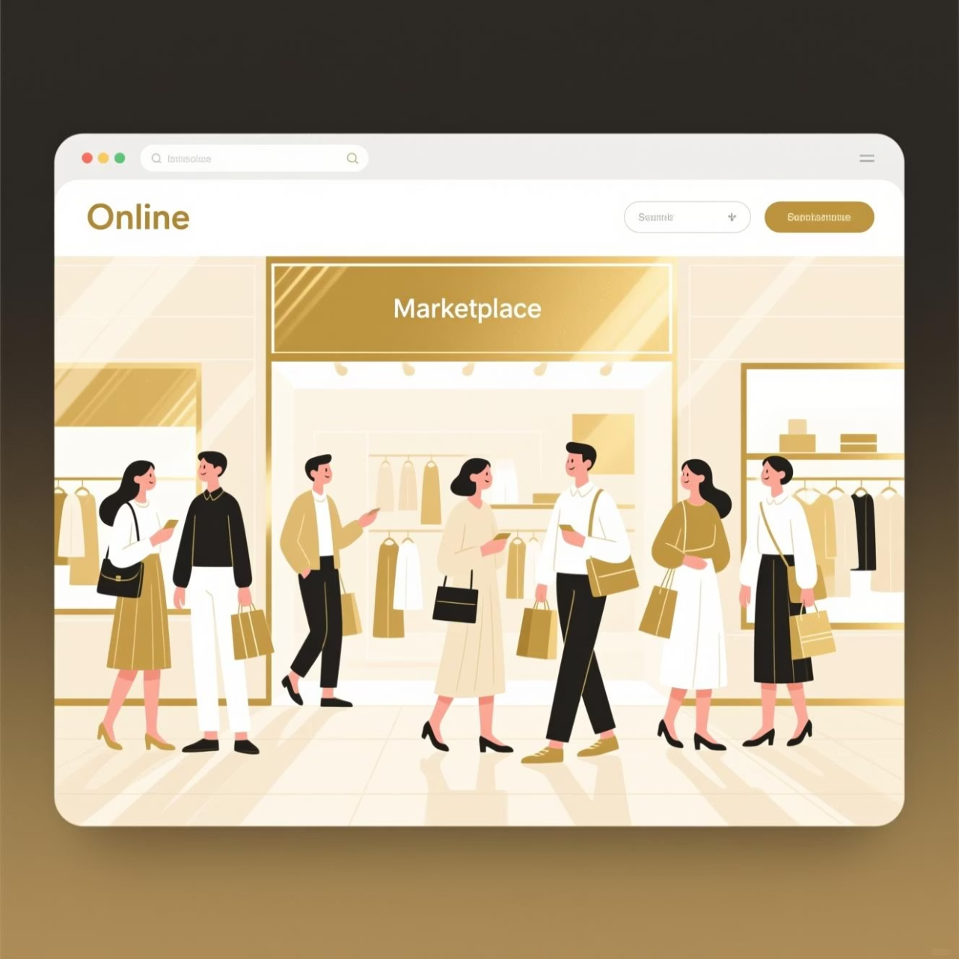
Our Solution
ClassKart connects the entire educational community through a secure, trusted online marketplace. We bridge the gap between students, teachers, parents, schools, and local suppliers—making educational resources accessible, affordable, and reliable nationwide.
Mission: Make quality learning materials available to every Rwandan student, regardless of location or circumstance.

Slide 4
What We Offer
Textbooks & Materials
Stationery & Supplies
Complete selection of approved textbooks, workbooks, and reference materials for all grade levels.
Quality notebooks, pens, pencils, and learning tools from verified local and national suppliers.
School Uniforms
Verified uniforms and accessories meeting school specifications, sourced from authentic tailors.

Slide 5
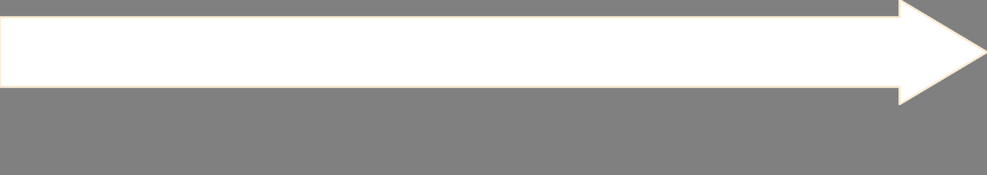

Smart Technology, Designed for You
Add to Cart
Browse & Discover
Select multiple items and review your selections before proceeding to checkout.
Explore our catalog by grade, subject, and school requirements with detailed descriptions and reviews.
Receive & Enjoy
Secure Checkout
Get your materials delivered locally or pick up at designated school locations.
Provide delivery details and choose your preferred payment method safely.

Slide 6
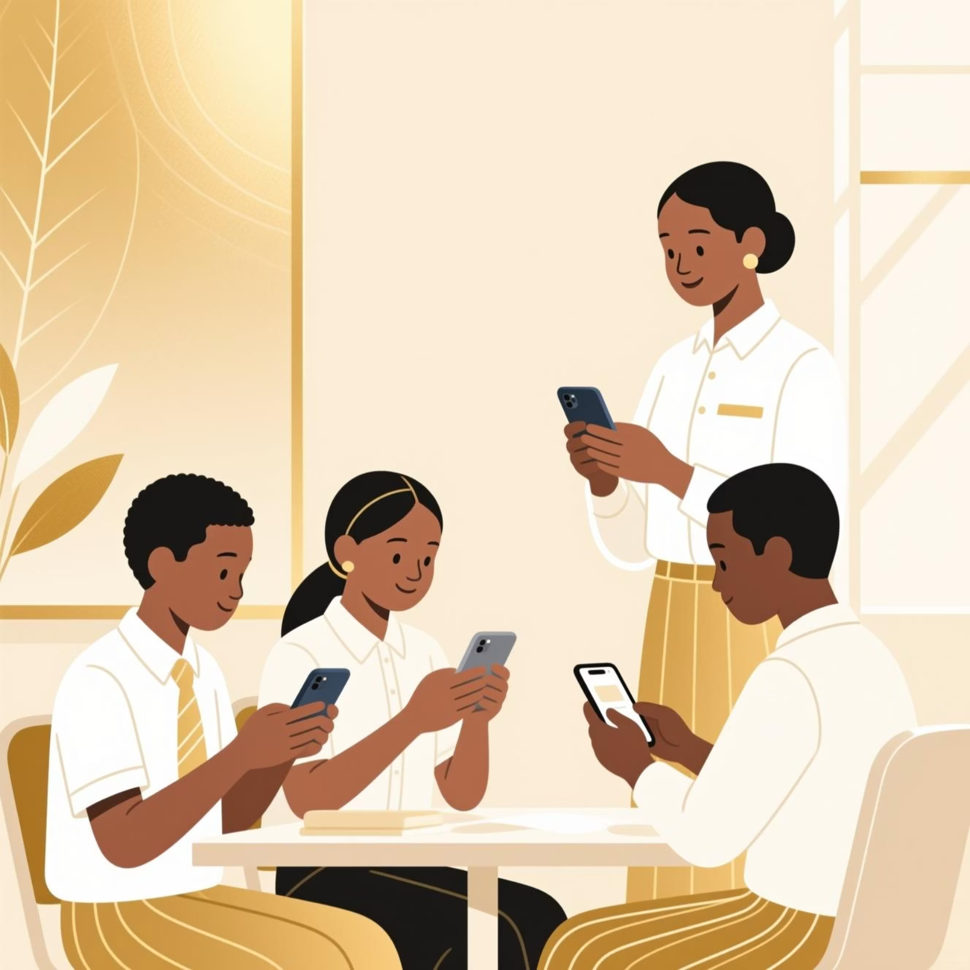
Marketing Strategy
How We Connect
Facebook, Instagram, and LinkedIn promotion
Direct partnerships with schools and institutions
Referral bonuses for students and parents
Back-to-school seasonal campaigns
SEO optimization for easy discovery online

Slide 7

Why Choose ClassKart?
Trusted & Verified
Affordable Prices
Fast Delivery
Local Support

Slide 8
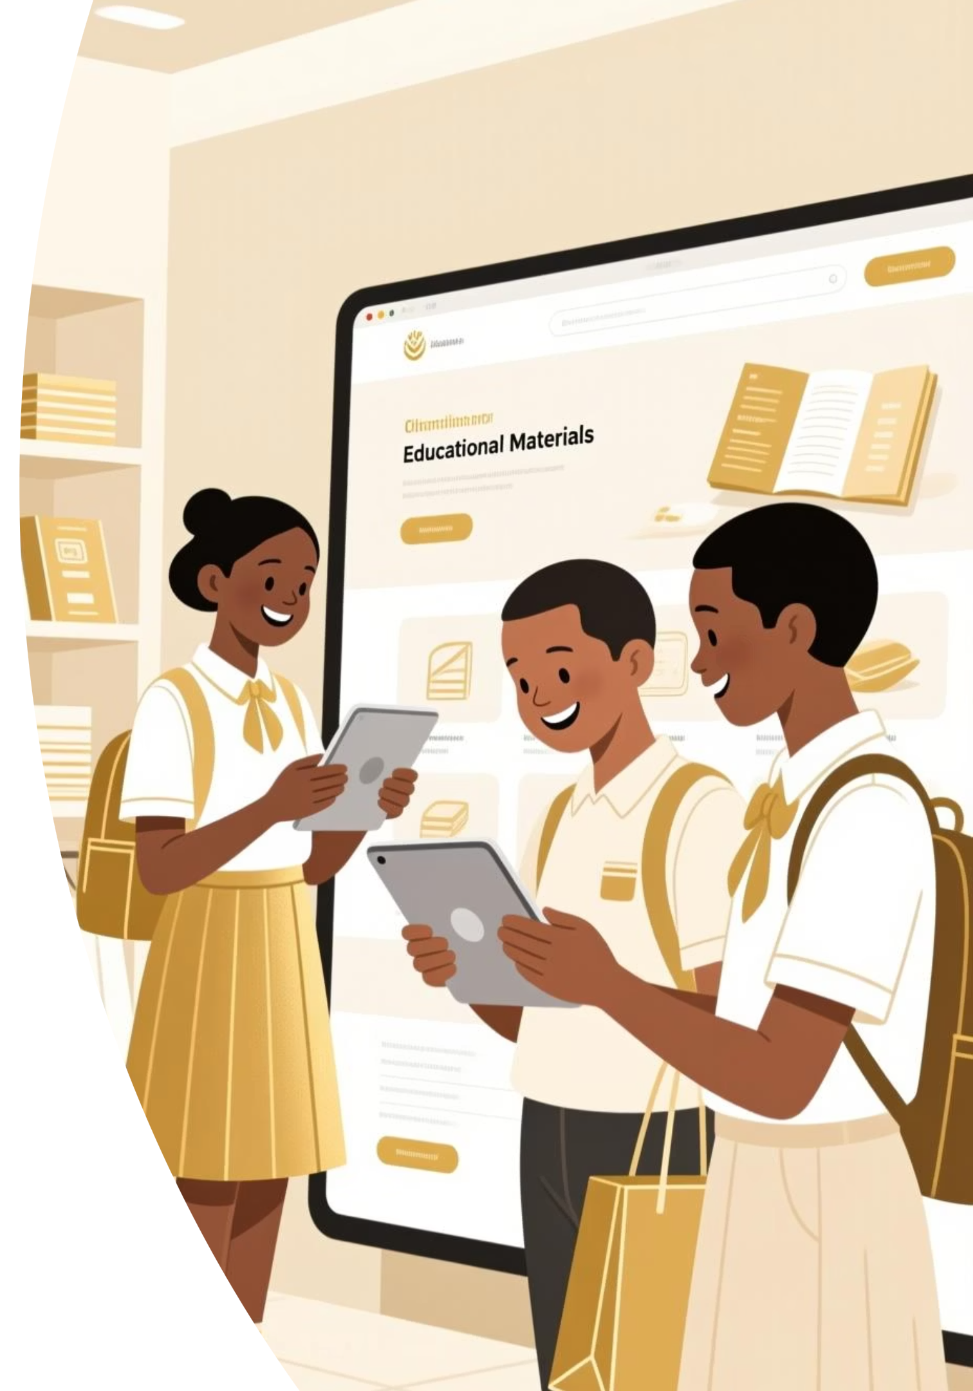
Join
ClassKart Today
📧 Email
🌐 Visit Us
info@classkart.rw
www.classkart.rw
Empowering Learning Through Access
Making quality education affordable and accessible for every Rwandan student, teacher, parent, and school.

